Slide 1
Design Patterns CHALLENGE
Endava bank, march 2018

Slide 2
agenda
refactor
Design patterns
demo
Q&A

Slide 3
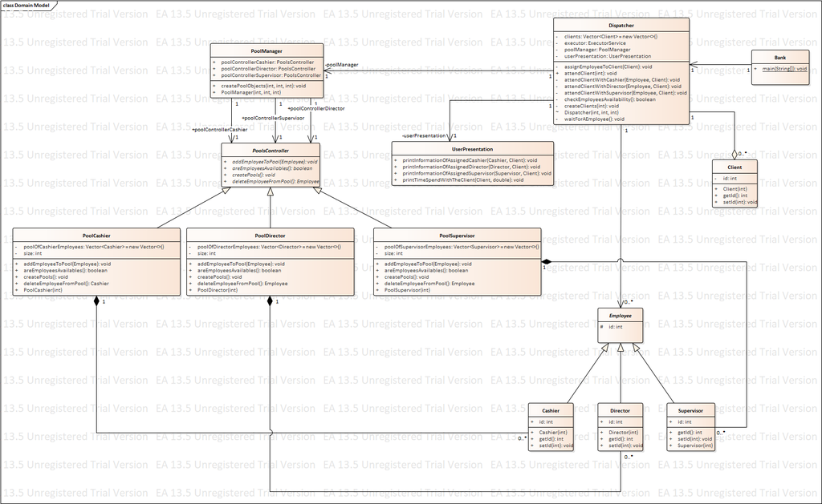
refactor
Before
After
UML_DIAGRAM

Slide 4
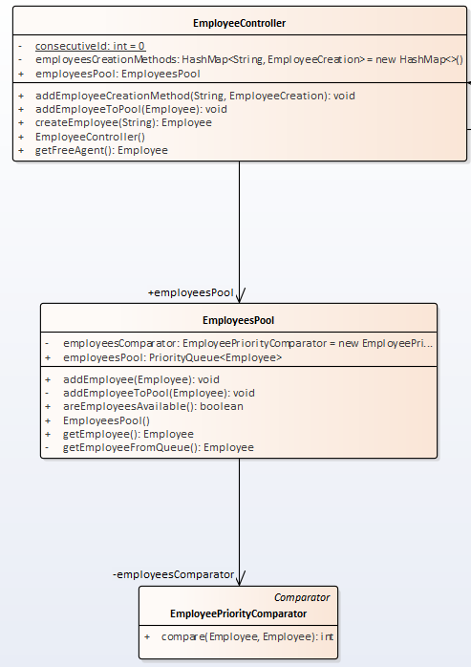
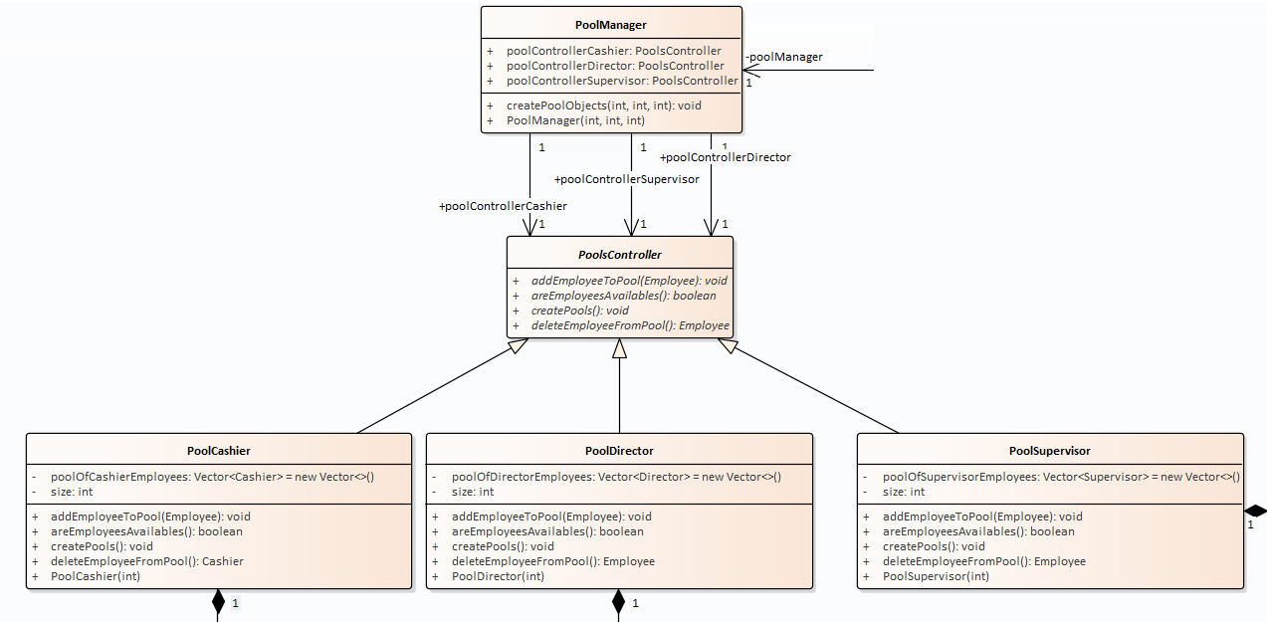
refactor
Before
After

Slide 5
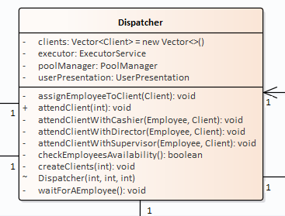
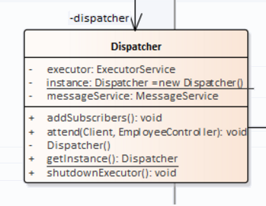
refactor
Before
After

Slide 6
agenda
refactor
Design patterns
demo
Q&A

Slide 7
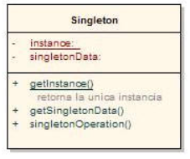
Singleton
structure
implementation

Slide 8
factory
structure
implementation

Slide 9
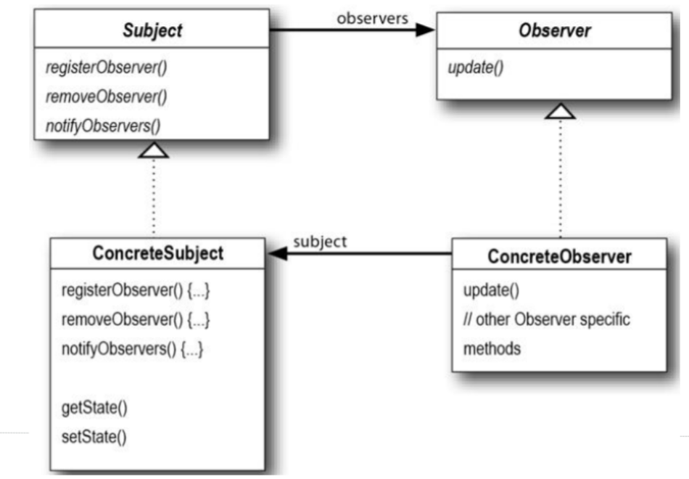
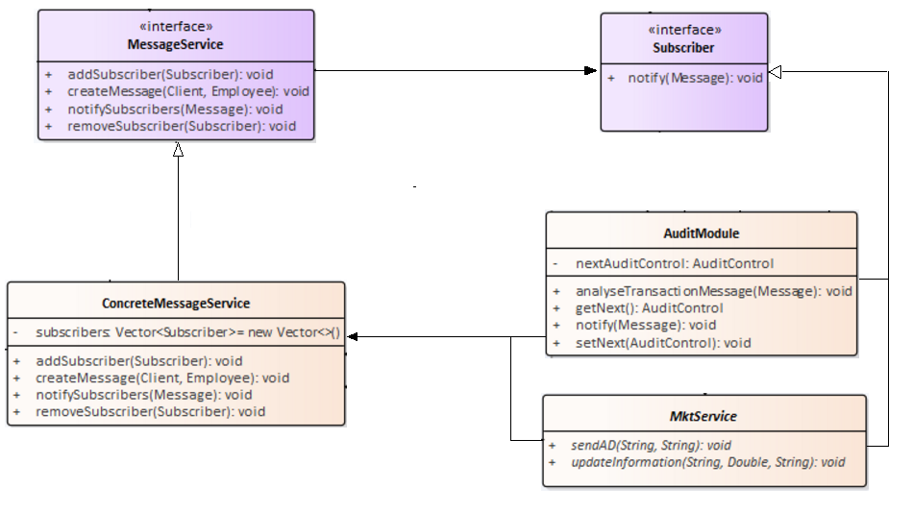
observer
structure
implementation

Slide 10
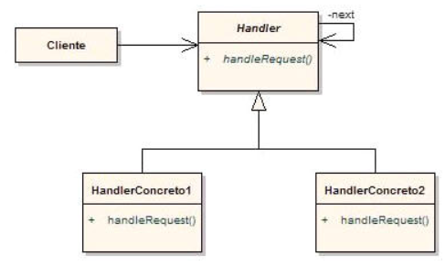
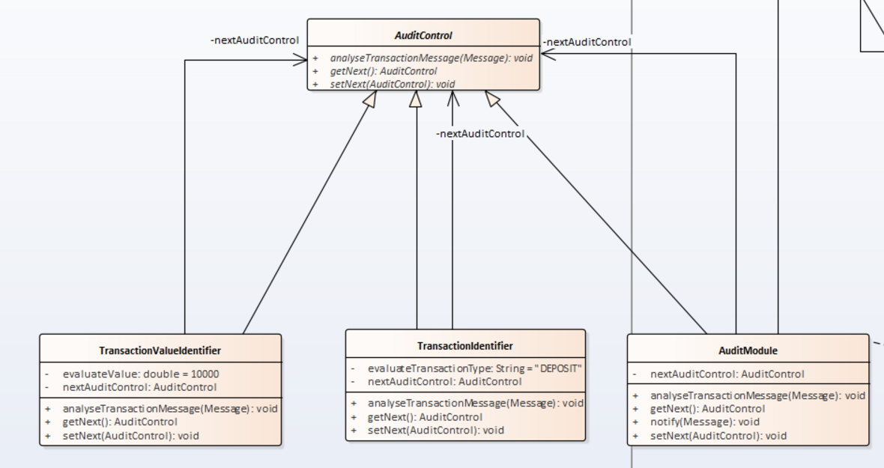
Chain of responsibility
structure
implementation

Slide 11
agenda
refactor
Design patterns
demo
Q&A

Slide 12
agenda
refactor
Design patterns
demo
Q&A

Slide 13

Q&a

Slide 14
Eduardo galeano
Application management
Luis Zarate
Testing
Sebastian puerto
devops

